Slide 1

Machine Learning Operations (MLOps) Overview, Definition, and Architecture
Abolfazl Yarian
Spring 2023

Slide 2
Outline
Introduction
Open-source tools
MLOps definition
1
3
5
2
4
6
Data science
Overview
Architecture
References

Slide 3
Data science steps for ML
Data extraction
Data analysis
Data preparation
Data cleaning
Data splitting
Transformation and feature engineering

Slide 4
Data science steps for ML
Model training
Implement different algorithm
Hyperparameter tuning
Model evaluation/validation
Model serving
Microservices
Edge device
Model monitoring

Slide 5
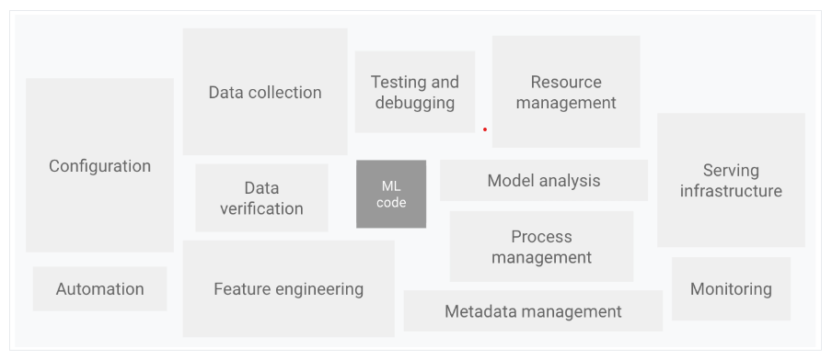

Slide 6
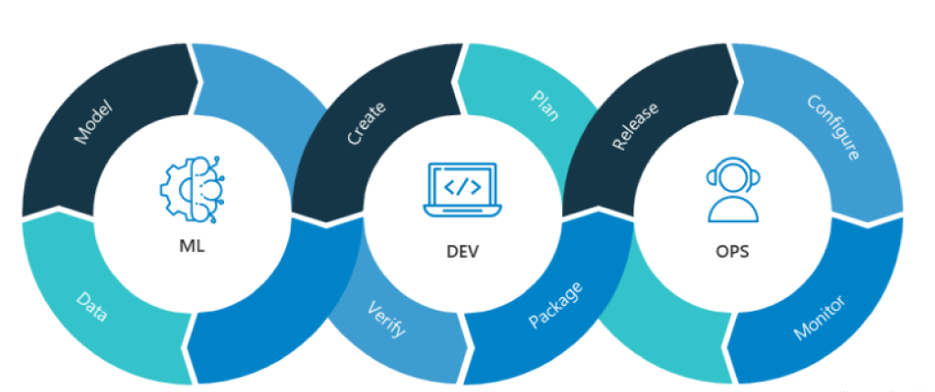
MLOps
MLOps (Machine Learning Operations) refers to the practice of applying DevOps (Development Operations) principles to the machine learning workflow. It involves a set of processes, tools, and techniques to build, deploy, monitor, and manage machine learning models in production environments

Slide 7
MLOps
MLOps manages and automates the end-to-end lifecycle of machine learning models.
Combines DevOps and data science to streamline development, deployment, and monitoring.
Improves collaboration, efficiency, and scalability by standardizing tools, processes, and infrastructure.
Enables continuous integration and delivery, ensuring reliability, security, and performance in production.
Involves monitoring, testing, and updating ML models to remain accurate and relevant.
Accelerates innovation, reduces costs, and improves customer satisfaction.

Slide 8
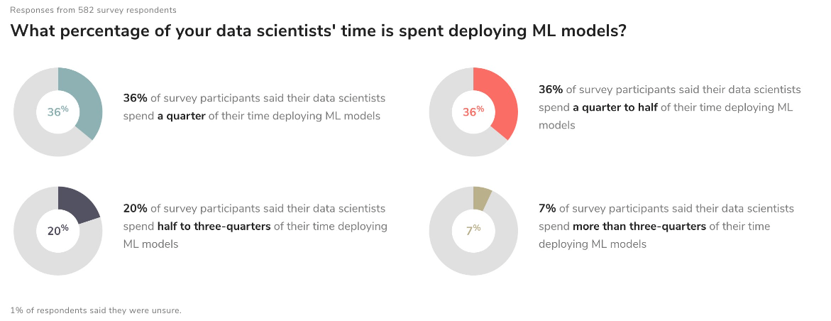

Slide 9
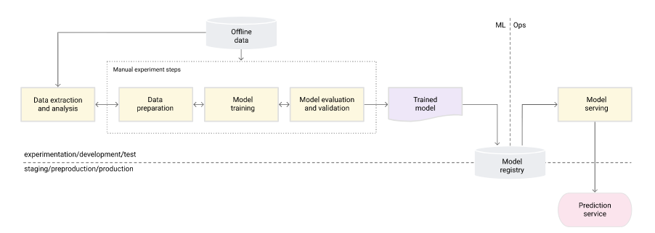
MLOps level 0: Manual process
what is TSD and TSR ?
Definition
Structure
Camera based
LIDAR based

Slide 10
Characteristics
Manual, script-driven, and interactive process
Disconnection between ML and operations
Infrequent release iterations
No CI/CD
Deployment refers to the prediction service
Lack of active performance monitoring

Slide 11
Challenges
Maintain model’s accuracy in production
Actively monitor the quality of your model in production
Frequently retrain your production models
Continuously experiment with new implementations to produce the model
Set up CT/CI/CD to rapidly test, build and deploy new implementation of the ML pipeline

Slide 12
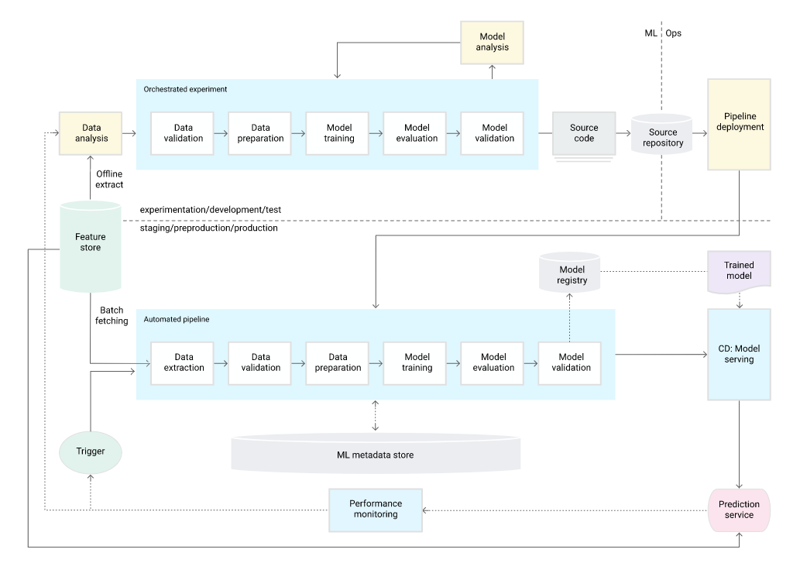
MLOps level 1: ML pipeline automation(CT)

Slide 13
Data validation
Data schema skews (stop)
Unexpected features
Unexpected values
Lack of all expected features
Data value skew (retrain)

Slide 14
Model validation (offline)
Evaluate predictive quality on test dataset
Compare with current model performance
Check for consistency across data segments
Test for deployment and infrastructure compatibility
Conduct online validation through canary or A/B testing

Slide 15
Feature store
Discover and reuse existing feature sets to avoid duplication
Serve up-to-date feature values from the feature store.
Use the feature store for experimentation, CT, and online serving to avoid training-serving skew.
avoid training-serving skew for:
Experimentation (offline)
continuous training
Online prediction

Slide 16
Metadata management
Record pipeline versions, timestamps, and executor for lineage, reproducibility, and debugging
Store parameter arguments passed to the pipeline
Store pointers to the artifacts produced by each step of the pipeline
Store pointers to previous models and evaluation metrics for comparison

Slide 17
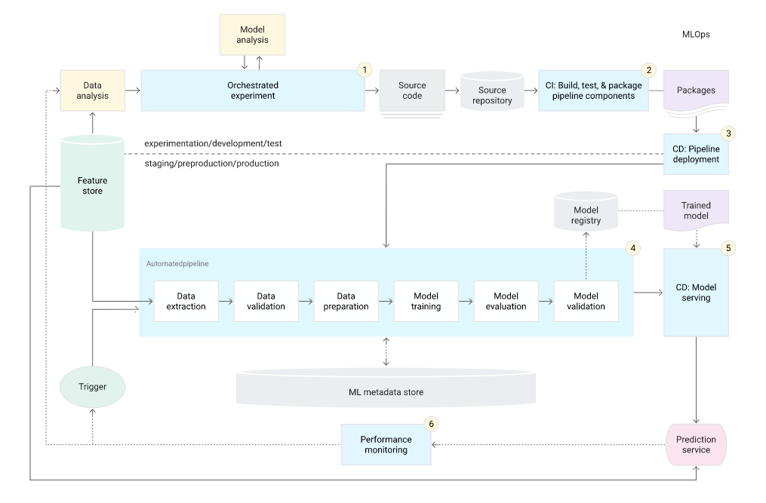
MLOps level 2: CI/CD pipeline automation

Slide 18
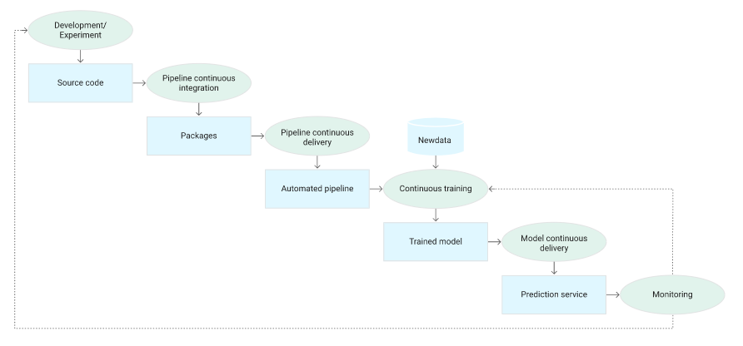
Characteristics
Development and experimentation
Pipeline continuous integration
Pipeline continuous delivery/deployment
Automated triggering
Model continuous delivery
Monitoring

Slide 19
Continuous integration
Unit tests for feature engineering and model methods in implementation
Tests for model convergence and avoiding NaN values
Testing that each component in the pipeline produces the expected artifacts
Testing integration between pipeline components.

Slide 20
Continuous delivery
Verify the compatibility of the model with the target infrastructure before deployment
Test the prediction service by calling the service API with expected inputs
Test prediction service performance by load testing to capture metrics such as QPS and model latency
Validate data for retraining or batch prediction
Verify that models meet predictive performance targets before deployment
Automate deployment to a test environment triggered by code push to development branch

Slide 21
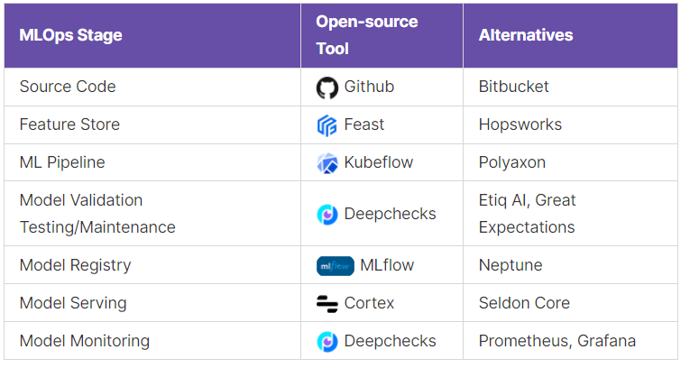
Open-source libraries

Slide 22
Thanks!
Any questions?

